Slide 1

Music Recommendation System Based on Mood
- HEMA
RAHUL
SNIGDHA

Slide 2

AIM:
The main objective of this project is to build a Mood Detection and Song Recommendation System that identifies a user's emotional state based on text input and recommends a list of songs that align with the detected mood.

Slide 3

OVERVIEW:
Dataset and Preprocessing
Machine Learning Model
Mapping Songs to Moods
Sentiment Analysis
Mood Detection from User Input
Conclusion and Future Scope

Slide 4


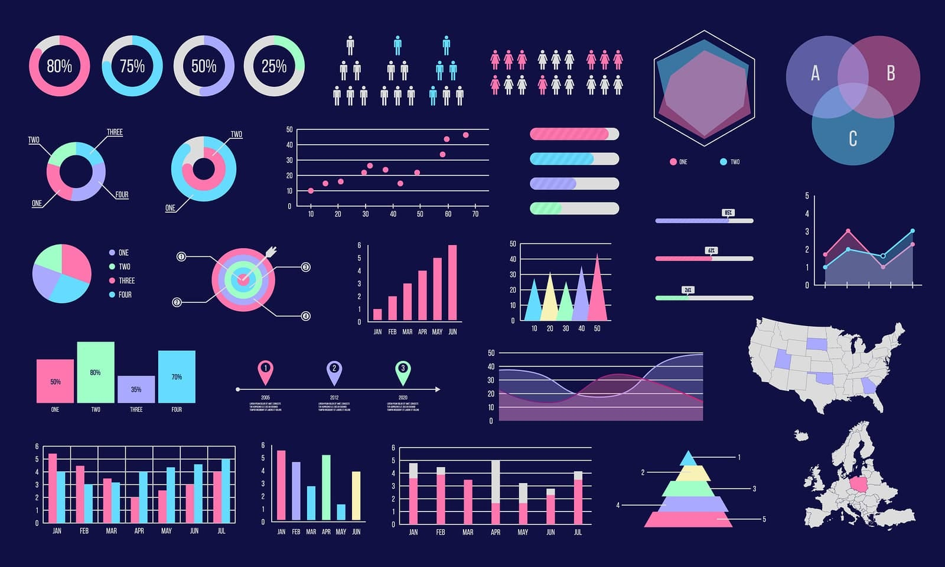
DATASET & PREPROCESSING:
Steps Involved:
Data Collection Data Cleaning Data Visualization

Slide 5
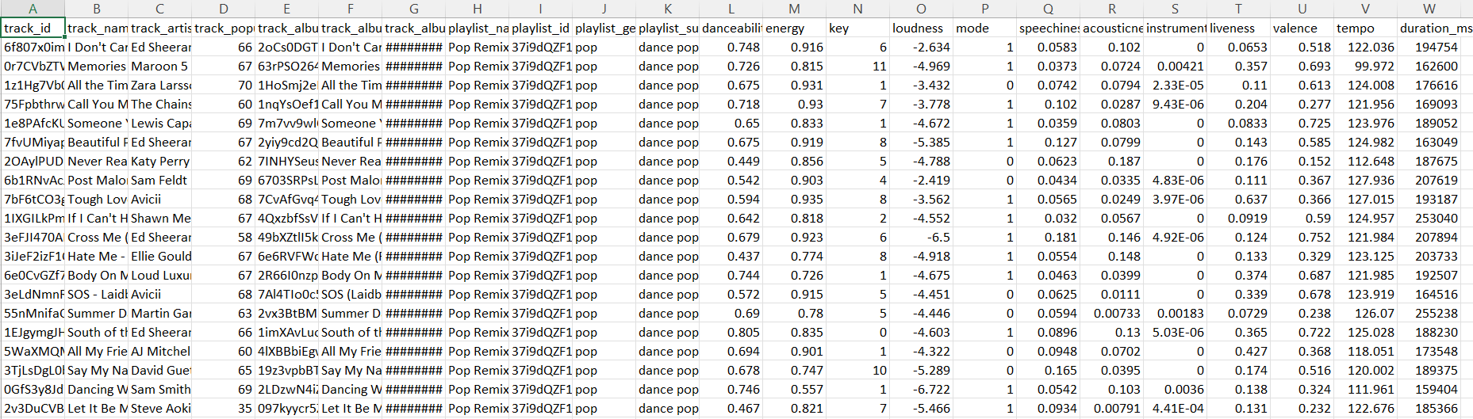
RAW DATA :

Slide 6
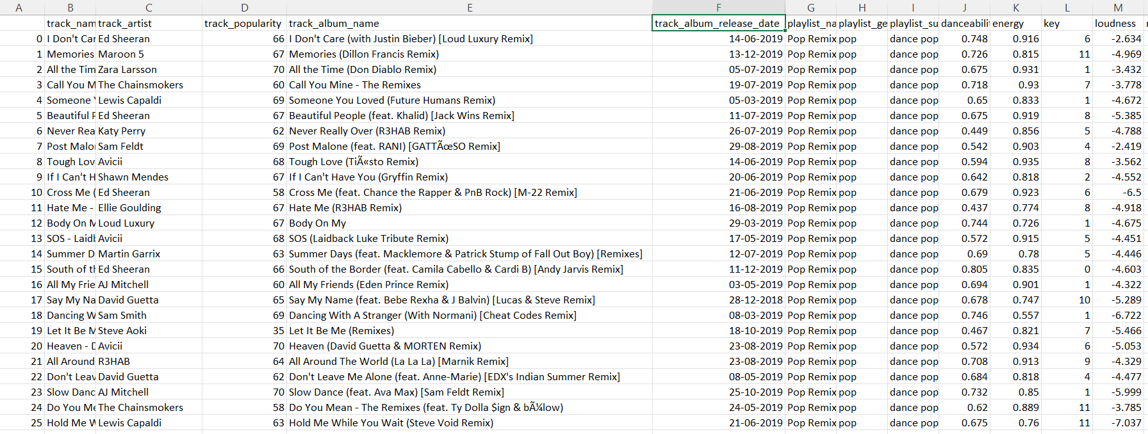
CLEANED DATA :

Slide 7
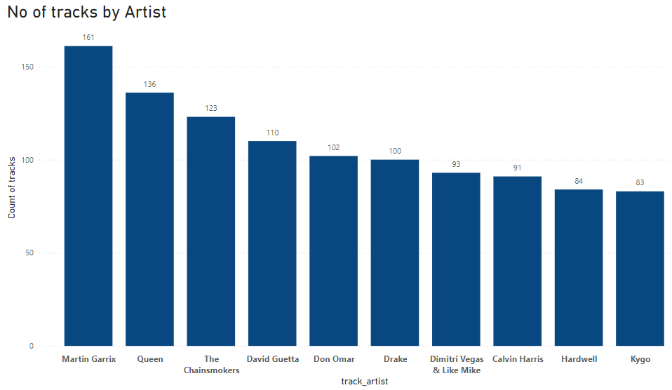
VISUALISATIONS:

Slide 8
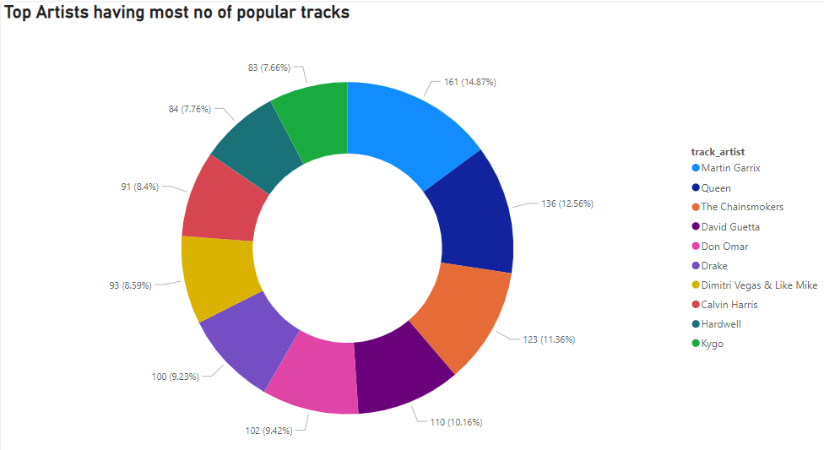

Slide 9
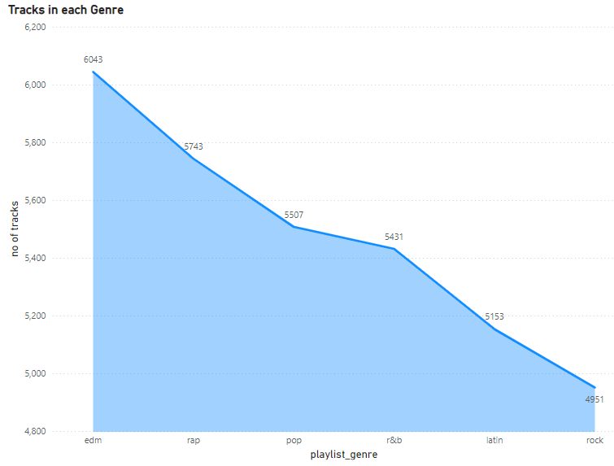

Slide 10
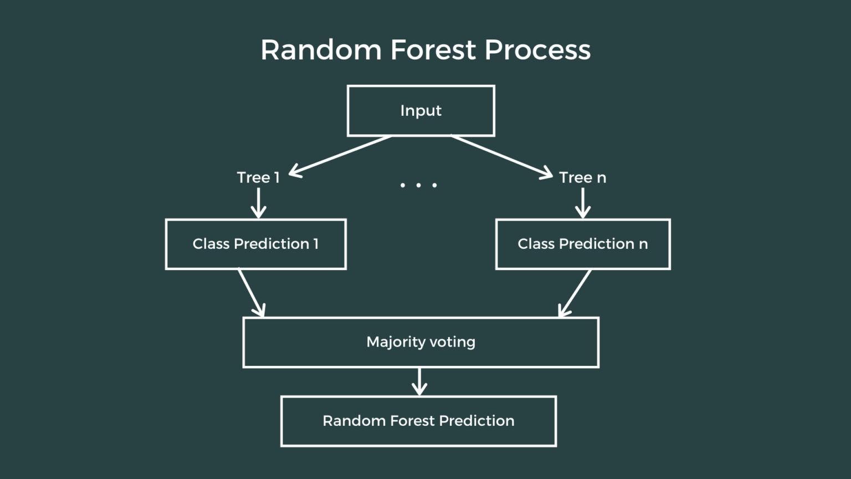
MACHINE LEARNING MODEL:
Model Used:
The RandomForest Classifier was chosen as the machine learning model for this project.
It is a robust and versatile algorithm that combines multiple decision trees to improve accuracy and prevent overfitting.
Its ability to handle complex datasets makes it well-suited for mood classification based on song features.

Slide 11
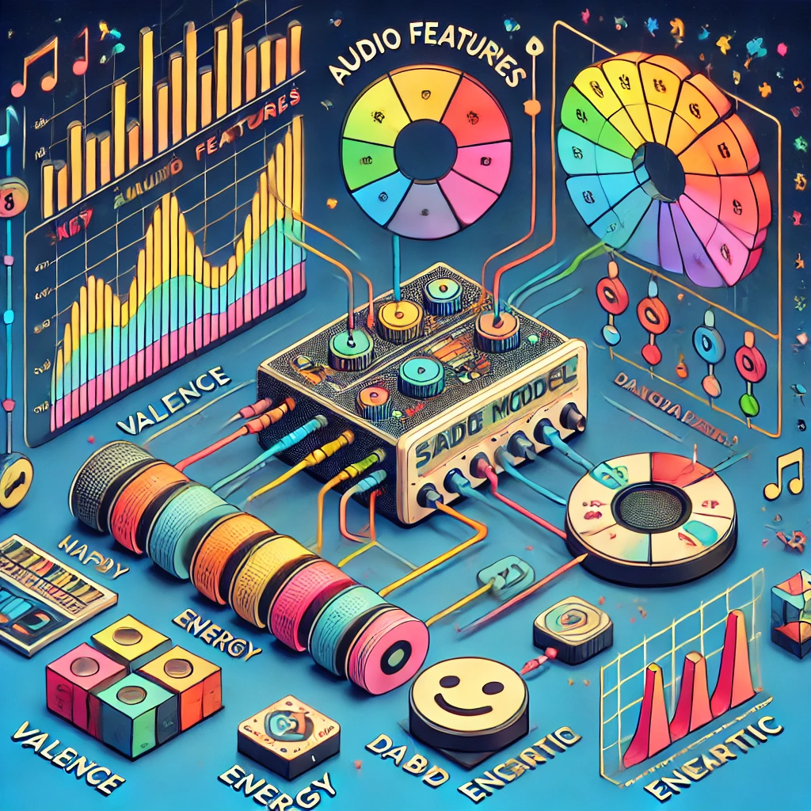
TRAINING:
The model was trained on a dataset containing key audio features such as valence, energy, danceability, and others.
These features were standardized using StandardScaler to ensure uniformity and improve model performance.
The training process involved learning patterns in the scaled data to accurately predict mood categories.

Slide 12
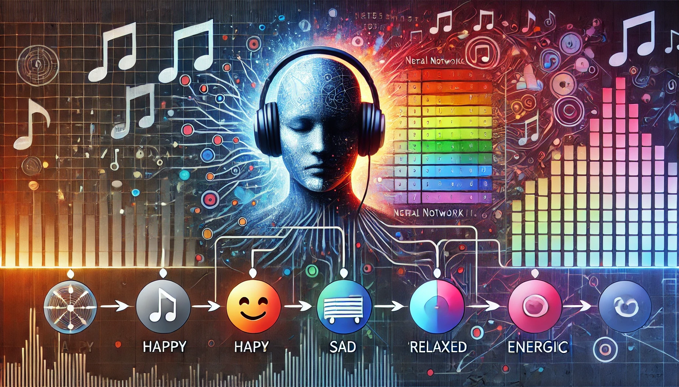
OUTPUT:
The model predicts the mood label as a numerical value (encoded format).
This encoded value is then translated back into its corresponding mood category (e.g., Happy, Sad, Relaxed, Energetic) using a LabelEncoder.
This final output aligns the detected mood with user-friendly categories for song recommendations.

Slide 13
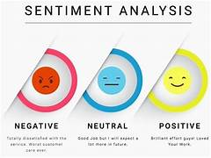
Tool Used: The system uses the Sentiment Intensity Analyzer from the NLTK library to evaluate the emotional tone of the user input.
Purpose: To analyze the user's text input and extract meaningful emotional cues to aid in mood detection.
Logic:
Sentiment scores (positive, negative, and compound) are calculated based on the input text.
These scores are then used to derive key features, such as valence (emotional positivity) and energy, which are essential for predicting the user's mood.

Slide 14

Mood Detection from User Input:
Sentiment-based features are extracted from the user’s text input using sentiment analysis.
The extracted features are fed into the trained model to predict the user’s mood.
Keywords in the input (e.g., "happy," "calm," "sad") are checked for additional mood clues.
If no keywords are found, the system uses the sentiment’s compound score to classify the mood.
KEYWORDS

Slide 15
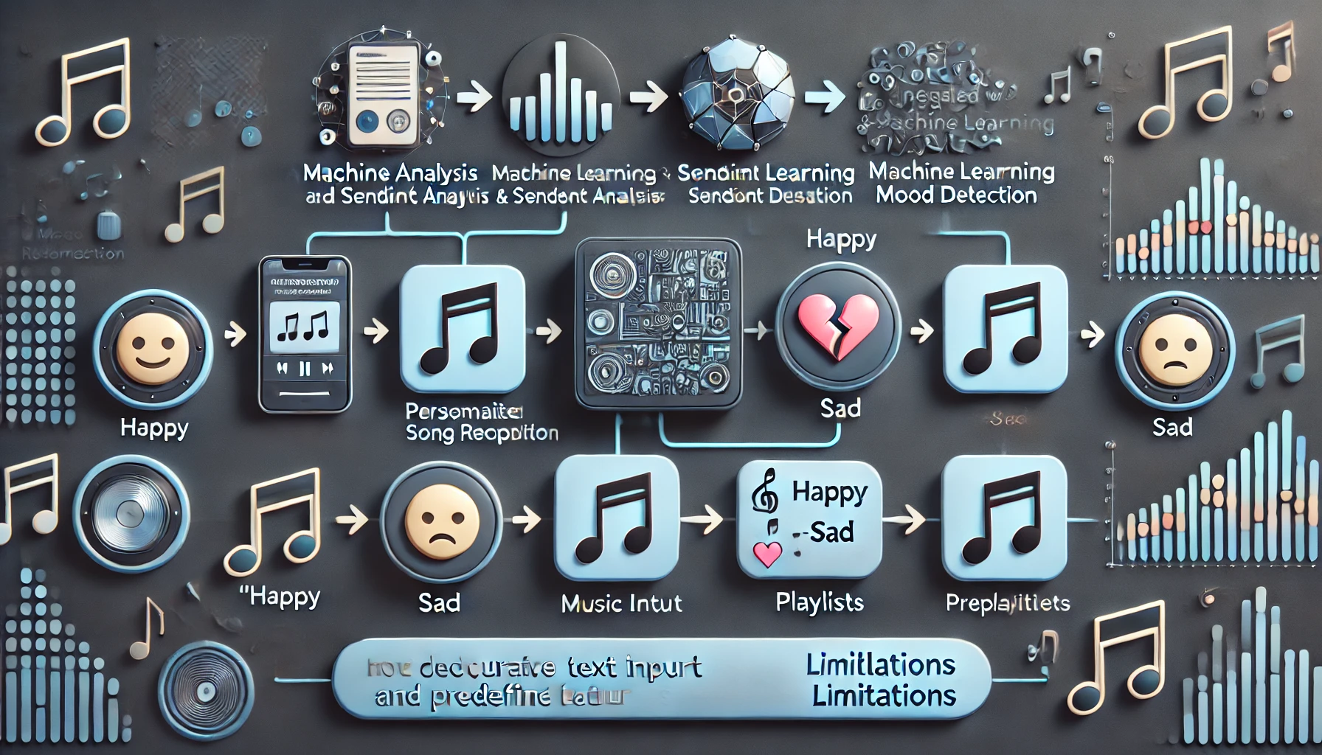
Key Outcomes: Combined a machine learning model with sentiment analysis to accurately detect user moods.
Provided personalized song recommendations tailored to the detected mood.
Highlighted limitations, such as the heavy reliance on user input text for mood classification and the restriction to predefined features and mood categories.

Slide 16

SUMMARY:
Key Insights: The project successfully showcased a user-friendly music recommendation system that aligns songs with the user's mood, creating a personalized listening experience.
Future improvements include adding more mood categories and features to enhance personalization and expanding the dataset to incorporate a wider variety of music genres and cultural diversity.

Slide 17

THANK YOU

